Slide 1
Murach’s Modern JavaScript
Chapter 16
How to work with drawing and animation

Slide 2
Objectives
Applied
Use the Canvas API to draw rectangles, text, lines, circles, and arcs on a web page.
Change the color of lines and shapes.
Create basic animations.
Use the HTML Drag and Drop API to make it possible to drag elements from one location on a web page and drop them in another.
Knowledge
Generally, describe what the Canvas API does and how it works.
Describe the use of fallback text for providing accessibility.
Define path in the context of the Canvas API.

Slide 3
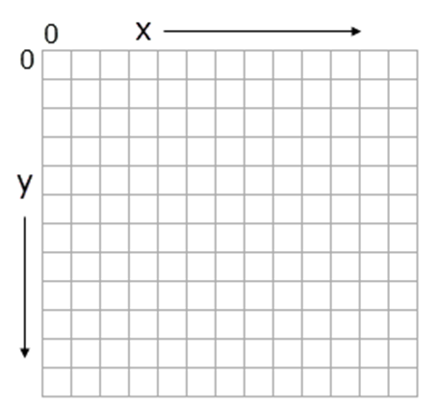
A <canvas> element within an HTML document
<body>
<h1>A canvas drawing</h1>
<canvas id="drawing" width="200" height="200">
</canvas>
<!-- additional content -->
</body>
The x and y coordinates of a <canvas> element

Slide 4
Get a 2D drawing context object for a <canvas> element
const canvas = document.querySelector("#drawing");
const ctx = canvas.getContext("2d");
Determine the location of the <canvas> element on the page
const rectangle = canvas.getBoundingClientRect();
const left = rectangle.x;
const top = rectangle.y;
A <canvas> element with fallback text
<canvas id="drawing" width="200" height="200">
smiley face</canvas>

Slide 5
Three methods of the drawing context object for working with rectangles
strokeRect(x, y, width, height)
fillRect(x, y, width, height)
clearRect(x, y, width, height)
Code used by the examples
const canvas = document.querySelector("canvas");
const ctx = canvas.getContext("2d");

Slide 6

Draw three rectangles
ctx.strokeRect(10, 10, 130, 130); // outer outline square
ctx.fillRect(30, 30, 90, 90); // inner solid square
ctx.clearRect(40, 60, 70, 30); // innermost clear
// rectangle
How it looks in the browser
Clear all drawing from a <canvas> element
ctx.clearRect(0, 0, canvas.width, canvas.height);

Slide 7

Two methods for working with text
strokeText(text, x, y)
fillText(text, x, y)
A property for working with text
font
Draw two words
ctx.font = "48px serif";
ctx.strokeText("Hello", 10, 60);
ctx.fillText("World!", 120, 50);
How it looks in the browser

Slide 8
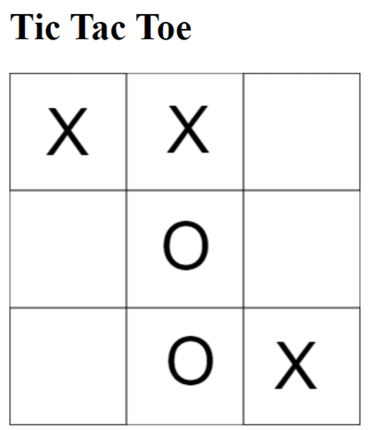
The user interface for the Tic Tac Toe app

Slide 9
The <body> element for the Tic Tac Toe app
<body>
<h1>Tic Tac Toe</h1>
<canvas width="300" height="300">
Tic Tac Toe board
</canvas>
<script src="tic_tac_toe.js"></script>
</body>

Slide 10
The JavaScript for the Tic Tac Toe app (part 1)
document.addEventListener("DOMContentLoaded", () => {
const canvas = document.querySelector("canvas");
const ctx = canvas.getContext("2d");
ctx.font = "56px arial"; // set font
const len = 100;
let isX = true;
// add squares at each corner and in the middle
ctx.strokeRect(0, 0, len, len); // upper left
ctx.strokeRect(0, 200, len, len); // lower left
ctx.strokeRect(200, 0, len, len); // upper right
ctx.strokeRect(200, 200, len, len); // lower right
ctx.strokeRect(100, 100, len, len); // middle
// add outer border
ctx.strokeRect(0, 0, canvas.width, canvas.height);

Slide 11
The JavaScript for the Tic Tac Toe app (part 2)
// event handler for click event
canvas.addEventListener("click", evt => {
const text = isX ? "X" : "O";
ctx.fillText(text, evt.offsetX, evt.offsetY);
isX = !isX; // toggle isX flag for next turn
});
});

Slide 12
Methods of the drawing context object for working with paths
beginPath()
moveTo(x, y)
lineTo(x, y)
closePath()
stroke()
fill()

Slide 13
Draw two lines
ctx.beginPath();
ctx.lineTo(25, 5); // same as calling moveTo()
ctx.lineTo(75, 5);
ctx.moveTo(125, 5); // lifts "pen" and places
// in new position
ctx.lineTo(175, 5);
ctx.stroke();
How it looks in the browser

Slide 14
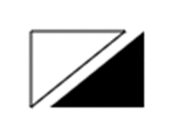
Draw two triangles
ctx.beginPath();
ctx.lineTo(10, 10);
ctx.lineTo(60, 10);
ctx.lineTo(10, 50);
ctx.closePath();
ctx.stroke(); // triangle outline
ctx.beginPath();
ctx.lineTo(20, 50);
ctx.lineTo(70, 10);
ctx.lineTo(70, 50);
ctx.fill(); // solid triangle – call to
// closePath() not needed
How it looks in the browser

Slide 15
Two properties of the drawing context object for working with paths
lineWidth
lineCap

Slide 16
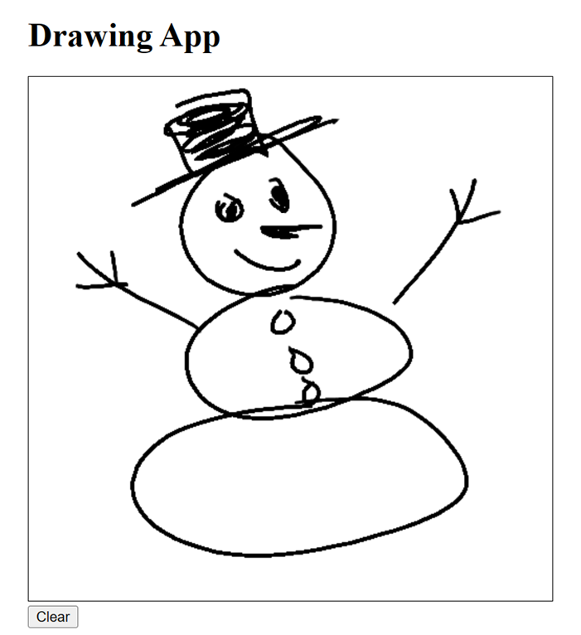
The user interface for the Drawing app

Slide 17
The <body> element for the Drawing app
<body>
<h1>Drawing App</h1>
<canvas width="500" height="500">
drawing surface
</canvas><br>
<button>Clear</button>
<script src="drawing.js"></script>
</body>
Some of the CSS for the Drawing app
canvas {
border: 1px solid black;
touch-action: none;
}

Slide 18
The drawing.js file (part 1)
document.addEventListener("DOMContentLoaded", () => {
// get canvas and context
const canvas = document.querySelector("canvas");
const ctx = canvas.getContext("2d");
// configure line style
ctx.lineWidth = 3;
ctx.lineCap = "round";
// flag to track state of drawing
let isDrawing = false;
// event handlers for mouse and touch
canvas.addEventListener("pointerdown", () => {
isDrawing = true;
ctx.beginPath();
});

Slide 19
The drawing.js file (part 2)
canvas.addEventListener("pointermove", evt => {
if (isDrawing) {
ctx.lineTo(evt.offsetX, evt.offsetY);
ctx.stroke();
}
});
canvas.addEventListener("pointerup", () =>
isDrawing = false);
canvas.addEventListener("pointerout", () =>
isDrawing = false);
// event handler for clear button
const btn = document.querySelector("button");
btn.addEventListener("click", () => {
ctx.clearRect(0, 0, canvas.width, canvas.height)
});
});

Slide 20
A method of the drawing context object for working with arcs
arc(x, y, radius, startAngle, endAngle,
[counterclockwise])

Slide 21

Draw three circles
ctx.beginPath();
ctx.arc(30, 50, 20, 0, Math.PI * 2);
ctx.moveTo(100, 50); // moves "pen" to new position
ctx.arc(80, 50, 20, 0, Math.PI * 2);
ctx.stroke(); // draws both circle outlines
ctx.beginPath();
ctx.arc(130, 50, 20, 0, Math.PI * 2);
ctx.fill(); // draws solid circle
How it looks in the browser

Slide 22

Draw two arcs
ctx.beginPath();
ctx.arc(30, 50, 20, 0, Math.PI); // half circle
ctx.moveTo(100, 50);
ctx.arc(80, 50, 20, 0, Math.PI / 2); // quarter circle
ctx.stroke();
How it looks in the browser

Slide 23

Draw a counterclockwise arc
ctx.beginPath();
ctx.arc(30, 50, 20, 0, Math.PI, true);
ctx.stroke();
How it looks in the browser

Slide 24
Two properties of the drawing context object for working with colors
strokeStyle
fillStyle
Valid CSS color values
ctx.strokeStyle = "blue";
ctx.strokeStyle = "#0000FF"; // same as "blue"
ctx.strokeStyle = "rgb(0,0,255)"; // same as "blue"
ctx.strokeStyle = "rgba(0,0,255,1)"; // same as "blue"

Slide 25

Draw a lavender circle with a purple outline
ctx.fillStyle = "lavender";
ctx.strokeStyle = "purple";
ctx.lineWidth = 5; // make outline 5 pixels wide
ctx.beginPath();
ctx.arc(70, 70, 50, 0, Math.PI * 2);
ctx.fill(); // fill circle
ctx.stroke(); // draw outline
How it looks in the browser

Slide 26

The Smiley Face app

Slide 27
The <body> element for the Smiley Face app
<body>
<h1>Have a nice day!</h1>
<canvas width="200" height="200">
smiley face
</canvas>
<script src="smiley.js"></script>
</body>

Slide 28
The JavaScript for the Smiley Face app (part 1)
const startAngle = 0, endAngle = Math.PI * 2;
function drawSolidCircle(x, y, radius, ctx) {
ctx.beginPath();
ctx.arc(x, y, radius, startAngle, endAngle);
ctx.fill();
};
document.addEventListener("DOMContentLoaded", () => {
const canvas = document.querySelector("canvas");
const ctx = canvas.getContext("2d");
ctx.fillStyle = "yellow";
drawSolidCircle(100, 100, 75, ctx); // yellow circle
ctx.fillStyle = "black";
drawSolidCircle(80, 70, 5, ctx); // left eye
drawSolidCircle(120, 70, 5, ctx); // right eye

Slide 29
The JavaScript for the Smiley Face app (part 2)
ctx.beginPath();
ctx.arc(100, 100, 75, startAngle, endAngle);
// outer circle outline
ctx.moveTo(135, 100);
ctx.arc(100, 100, 35, startAngle, Math.PI);
// mouth (half circle)
ctx.stroke(); // draw outline and mouth
});

Slide 30
A method of the window object for working with animations
requestAnimationFrame(function)
Move a square from side to side (part 1)
let x = 0;
let increment = 2;
const moveSquare = () => {
// clear previous square (if any) and draw new one
ctx.clearRect(0, 0, canvas.width, canvas.height);
ctx.fillRect(x, 100, 10, 10);
// reverse direction if at either side of canvas
if (x < 0 || x > canvas.width - 10 ) {
increment = -increment;
}

Slide 31
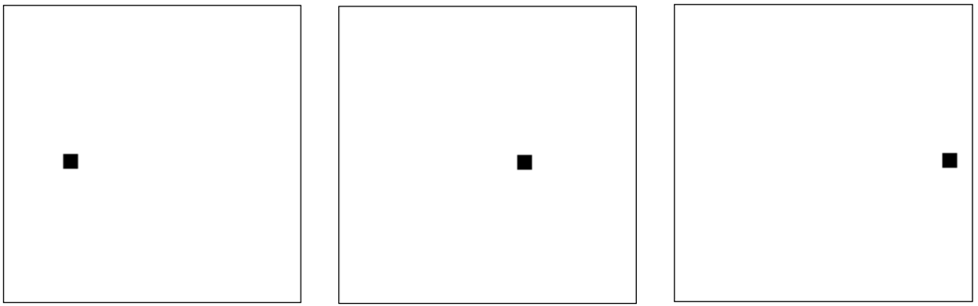
Move a square from side to side (part 2)
// calculate new x value
x += increment;
// continue animation
requestAnimationFrame(moveSquare);
};
// start animation;
requestAnimationFrame(moveSquare);
How it looks in the browser

Slide 32
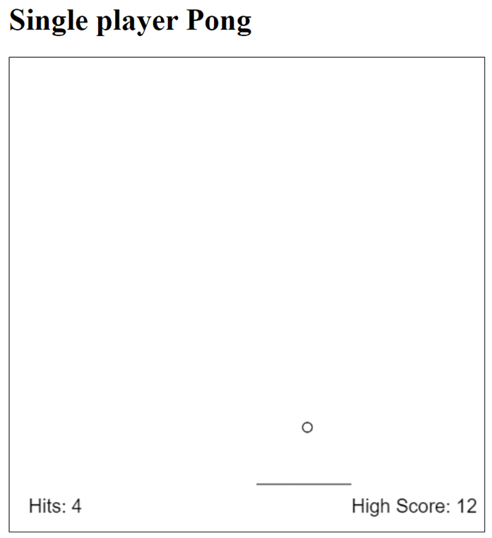
The user interface for the Pong app

Slide 33
The <body> element for the Pong app
<body>
<h1>Single player Pong</h1>
<canvas width="500px" height="500px">
Pong game display
</canvas>
<script src="pong.js"></script>
</body>
Some of the CSS for the Pong app
canvas {
border: 1px solid black;
}

Slide 34
The pong.js file (part 1)
document.addEventListener("DOMContentLoaded", () => {
// get canvas and context
const canvas = document.querySelector("canvas");
const context = canvas.getContext("2d");
// set constant for midpoint of x-axis
const midX = canvas.width / 2;
// define objects for ball, paddle, and player
// with starting values
let ball = {x: midX, y: 0, speedX: 1, speedY: 5};
const paddle = {x: midX - 50, y: canvas.height - 50,
len: 100, direction: 0};
const player = {hits: 0, highScore: 0};

Slide 35
The pong.js file (part 2)
// callback function for requestAnimationFrame()
const render = () => {
// calculate paddle position
paddle.x = paddle.x + paddle.direction;
// calculate ball position
ball.x = ball.x + ball.speedX;
ball.y = ball.y + ball.speedY;
// if ball hits right/left border, reverse x speed
// to simulate bounce
if (ball.x < 0 || ball.x > canvas.width)) {
ball.speedX = -ball.speedX;
}
// if ball hits top border, reverse y speed
// to simulate bounce
if (ball.y < 0) {
ball.speedY = -ball.speedY;
}

Slide 36
The pong.js file (part 3)
// if ball is below paddle level...
if (ball.y > paddle.y) {
const isLeftOfPaddle = ball.x < paddle.x;
const isRightOfPaddle =
ball.x > paddle.x + paddle.len;
if (isLeftOfPaddle || isRightOfPaddle) {
// missed - start over
ball = {x: midX, y: 0, speedX: 1, speedY: 5};
player.hits = 0;
} else {
// hit - reverse y speed to simulate bounce
ball.speedY = -ball.speedY;
// Change x speed based on where ball hits
// paddle. If near middle, angle of ball is
// more up-and-down. If near ends, angle is
// more side-to-side.
const midPaddle =
paddle.x + (paddle.len / 2);
ball.speedX = .1 * (ball.x - midPaddle);

Slide 37
The pong.js file (part 4)
// increment hits and update high score
// if necessary
player.hits++;
if (player.hits > player.highScore) {
player.highScore = player.hits;
}
}
}
// clear previous drawing and start new path
context.clearRect(0, 0, canvas.width,
canvas.height);
context.beginPath();
// ball
context.arc(ball.x, ball.y, 5, 0, Math.PI * 2);
// paddle
context.moveTo(paddle.x, paddleY);
context.lineTo(paddle.x + paddle.len, paddleY);

Slide 38
The pong.js file (part 5)
// draw ball and paddle
context.stroke();
// draw hit count and high score text
context.font = "20px sans-serif";
context.fillText("Hits: " + player.hits, 20,
paddle.y + 30);
context.fillText("High Score: " + player.highScore,
canvas.width - 140, paddle.y + 30);
// continue animation
requestAnimationFrame(render);
};

Slide 39
The pong.js file (part 6)
// event handlers
document.addEventListener("keydown", e => {
if (e.code == "ArrowLeft") paddle.direction = -5;
if (e.code == "ArrowRight") paddle.direction = 5;
});
document.addEventListener("keyup", () => {
paddle.direction = 0;
});
// start animation
requestAnimationFrame(render);
});

Slide 40
Three common drag events
dragstart
dragover
drop

Slide 41
The HTML for the following example
<div id="left">
<p id="dragme" draggable="true">Drag me!</p>
</div>
<div id="right"></div>

Slide 42
Drag and drop <p> element to and from <div> elements (part 1)
const dragme = document.querySelector("#dragme"); // <p> element
const left = document.querySelector("#left"); // left <div>
const right = document.querySelector("#right"); // right <div>
// event handlers for the drag events
const dragStartHandler = evt =>
evt.dataTransfer.setData("p", evt.target.id);
// store element id
const dragOverHandler = evt => evt.preventDefault();
const dropHandler = evt => {
evt.preventDefault();
const id = evt.dataTransfer.getData("p");
// retrieve element id
const p = document.querySelector("#" + id);
evt.target.appendChild(p);
};

Slide 43
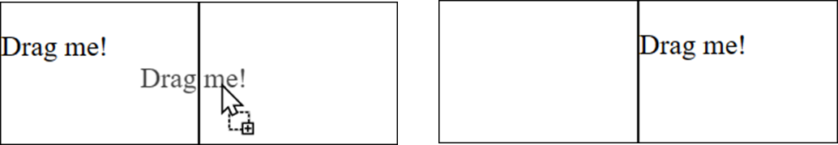
Drag and drop <p> element (part 2)
// make <p> element draggable
dragme.addEventListener("dragstart", dragStartHandler);
// make right <div> element a drop target
right.addEventListener("dragover", dragOverHandler);
right.addEventListener("drop", dropHandler);
// make left <div> element a drop target (so can drag element back)
left.addEventListener("dragover", dragOverHandler);
left.addEventListener("drop", dropHandler);
How it looks in the browser
During drag After drop

Slide 44
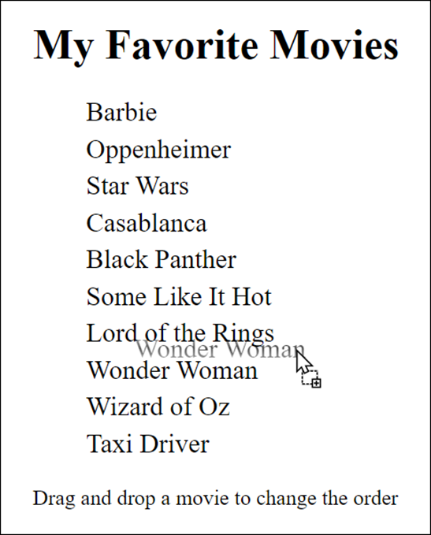
The Movie List app

Slide 45
The <body> element for the Movie List app
<body>
<h1>My Favorite Movies</h1>
<ul>
<li id="barbie">Barbie</li>
<li id="op">Oppenheimer</li>
...
<li id="taxi">Taxi Driver</li>
</ul>
<p>Drag and drop a movie to change the order</p>
<script src="movie_list.js"></script>
</body>

Slide 46
The JavaScript for the Movie List app
document.addEventListener("DOMContentLoaded", () => {
const movies = document.querySelectorAll("li");
// make movie list items draggable and droppable
for (let movie of movies) {
movie.draggable = true;
movie.addEventListener("dragstart", evt =>
evt.dataTransfer.setData("id", evt.target.id));
movie.addEventListener("dragover", evt =>
evt.preventDefault());
movie.addEventListener("drop", evt => {
evt.preventDefault();
const id = evt.dataTransfer.getData("id");
const li = document.querySelector("#" + id);
evt.currentTarget.parentNode.insertBefore(
li, evt.target);
});
}
});

